Slide 1
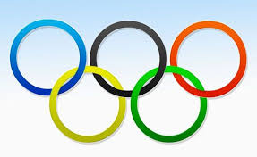

Olympic Evolution: Athletes, Nations & Performance Trends (1896–2024) Ali Raza | DAPT10
Notes:
Use BLUE background with abstract ribbon design and subtle Olympic rings.

Slide 2

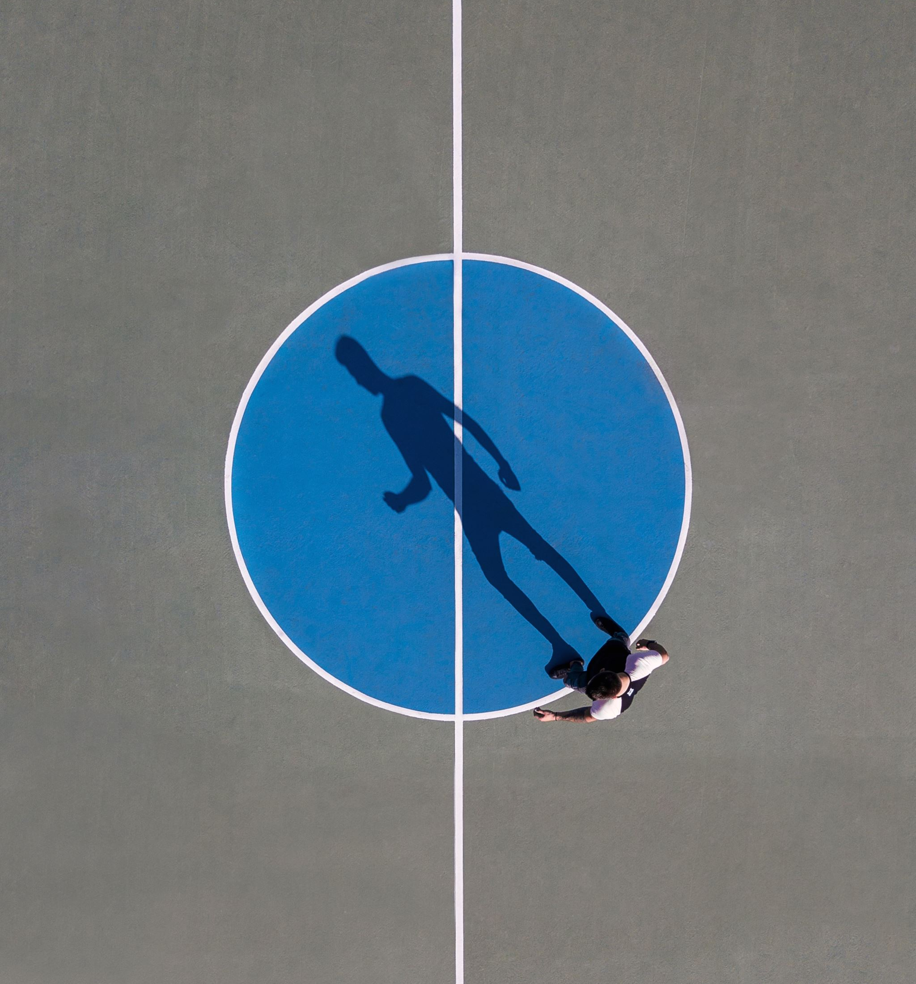
The Problem
The Olympic Games have brought athletes together for over 120 years, but issues like participation, gender equality, and performance trends remain unclear due to limited analysis of their evolution and shifting national representation.
Notes:
Use YELLOW abstract background with soft gradient and Olympic ring overlay.

Slide 3
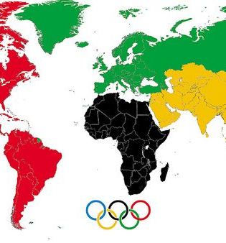
Objectives
Objectives:
Examine participation and medals by year, country, and gender.
Identify top countries and popular sports.
Track gender representation growth.
Highlight shifts in dominance and inclusivity from 1896 to 2022.
Notes:
Use GREEN gradient background with abstract waves and Olympic rings.

Slide 4
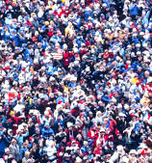
The Audience
Audience: Sports analysts, Olympic committees, media, academics, and the public interested in Olympic fairness, inclusivity, trends, and global sports representation.
Notes:
Use GOLD abstract background with smooth curves and faint Olympic rings logo in bottom corner.

Slide 5
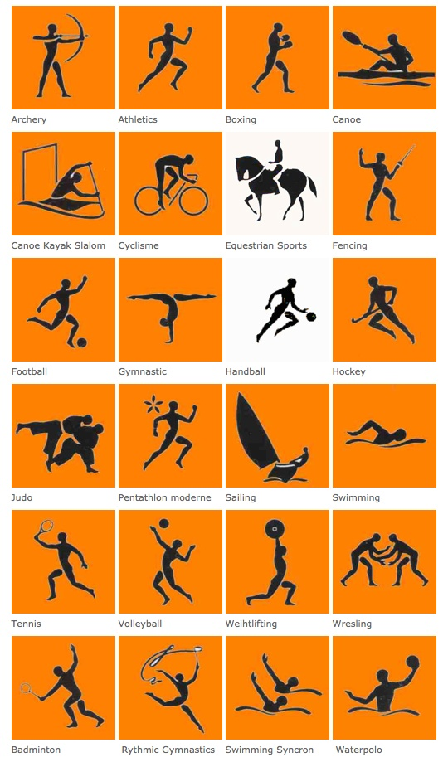
The Beginning of Olympics
Notes:
Use GREEN gradient background with abstract waves and Olympic rings.

Slide 6
When did it all begin?
You might know famous teams, athletes, and the rules well, but do you know when, where, and how it all started?
Notes:
Use GREEN gradient background with abstract waves and Olympic rings.

Slide 7
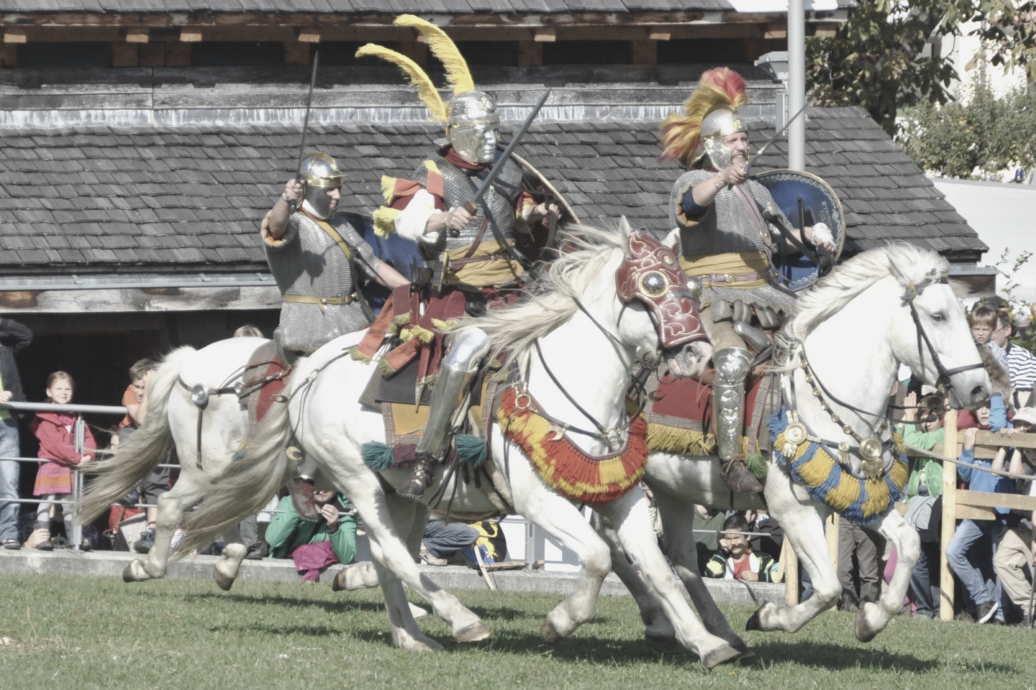
3,000 YEARS AGO
Athletic activities were less focused on competition and more on training and readiness for warfare. Consequently, many of the earliest sports centered around skills like spear throwing, stone throwing, and individual combat practice.
Notes:
Use GREEN gradient background with abstract waves and Olympic rings.

Slide 8
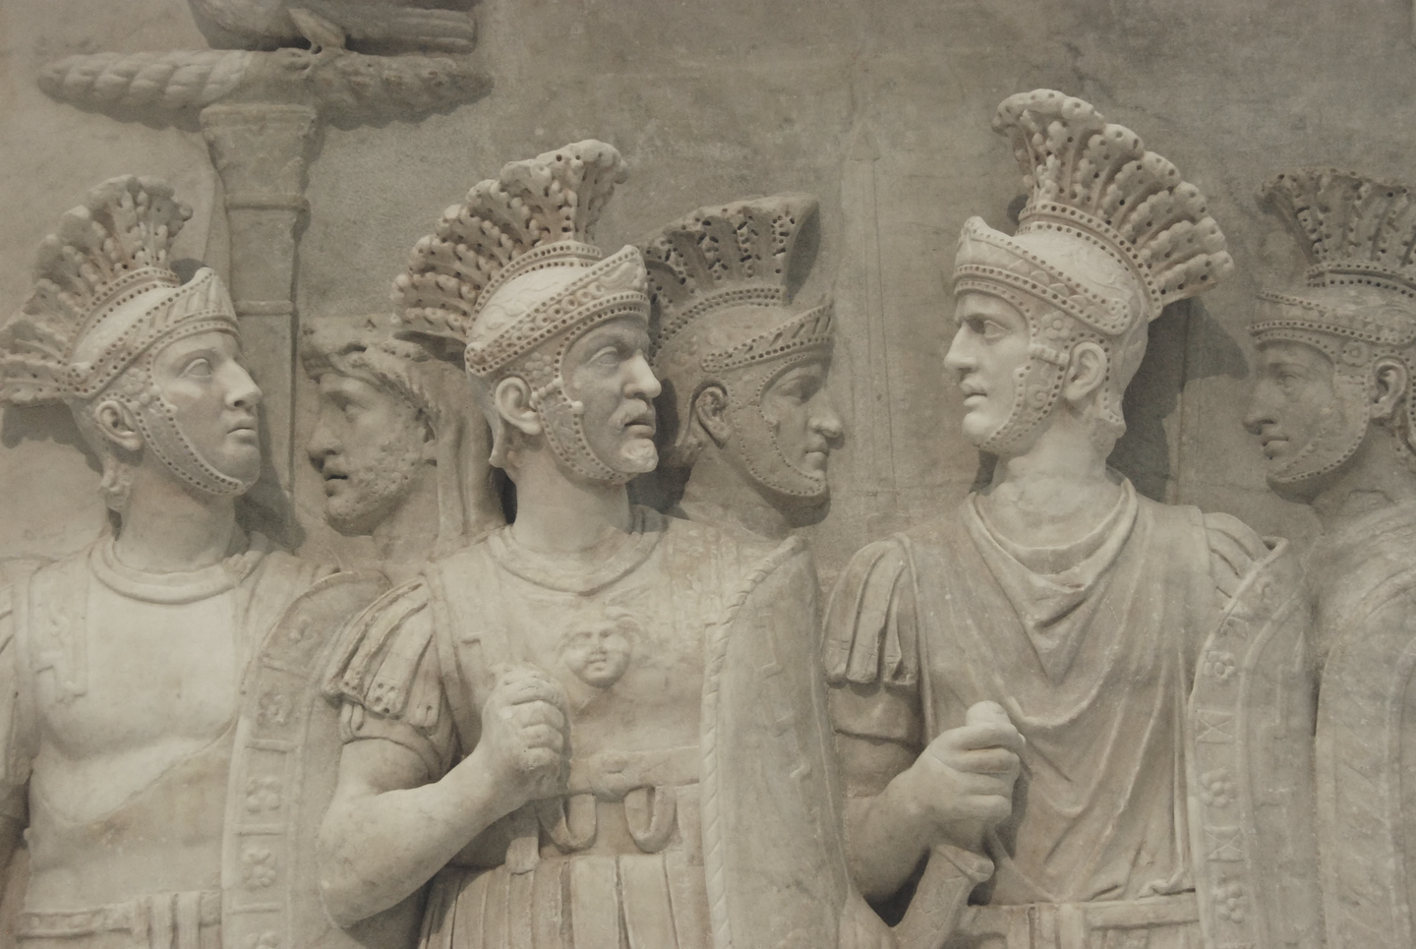
Thanks to the Ancient Greeks
Organized sports first appeared worldwide with events like foot and chariot racing, jumping, discus and javelin throwing, and wrestling at the first Olympic Games in 776 BC.
Notes:
Use GREEN gradient background with abstract waves and Olympic rings.

Slide 9

It was All Fun & Games, Until..
Notes:
Use GREEN gradient background with abstract waves and Olympic rings.

Slide 10
The Beginning.
1. Introduction: The modern Olympics began in 1896 in Athens, growing from 241 athletes then to over 10,000 expected in 2026.
2. Early Years: The first Games included only men from 14 countries, with women joining in 1900 and the Winter Olympics starting in 1924.
3. Challenges: The Olympics have faced interruptions from world wars, political boycotts, and the COVID-19 pandemic, with the IOC guiding global growth.
Notes:
Use GREEN gradient background with abstract waves and Olympic rings.

Slide 11
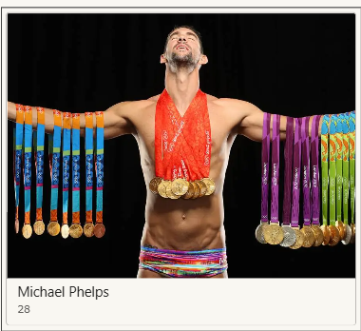
Some interesting facts and records
Michael Phelps holds the record for the most medals won by any athlete, totaling 28.
Notes:
Use GREEN gradient background with abstract waves and Olympic rings.

Slide 12
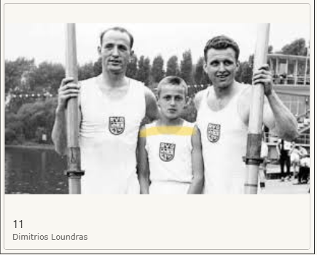
Some interesting facts and records
Dimitrios Loundras, a Greek athlete, competed at the age of 11, making him the youngest participant.
Notes:
Use GREEN gradient background with abstract waves and Olympic rings.

Slide 13
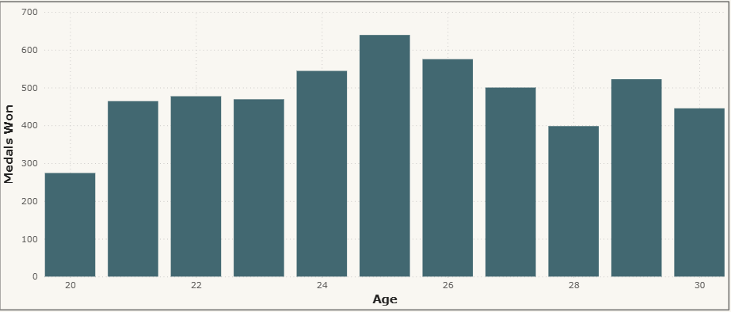
The data indicates that the age group with the highest success rate ranges from 20 to 30 years, with 25 years being the peak age for performance.
Notes:
Use GREEN gradient background with abstract waves and Olympic rings.

Slide 14
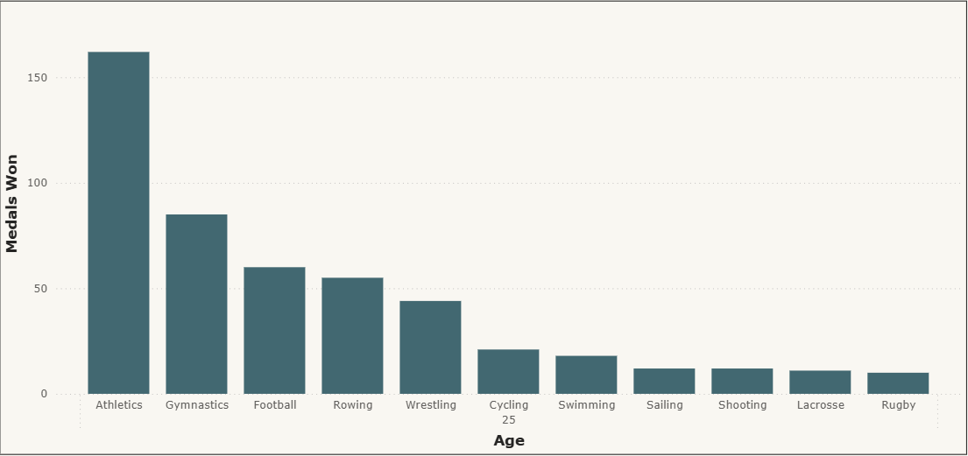
These sports have seen athletes achieve the greatest success when they reach their prime age of 25.
Notes:
Use GREEN gradient background with abstract waves and Olympic rings.

Slide 15
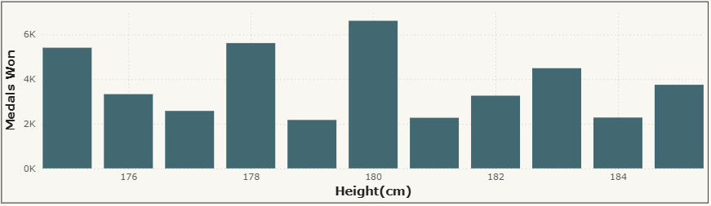
This chart illustrates the correlation between athletes’ height and success, highlighting that 180 cm is the most common height among top performers.
Notes:
Use GREEN gradient background with abstract waves and Olympic rings.

Slide 16
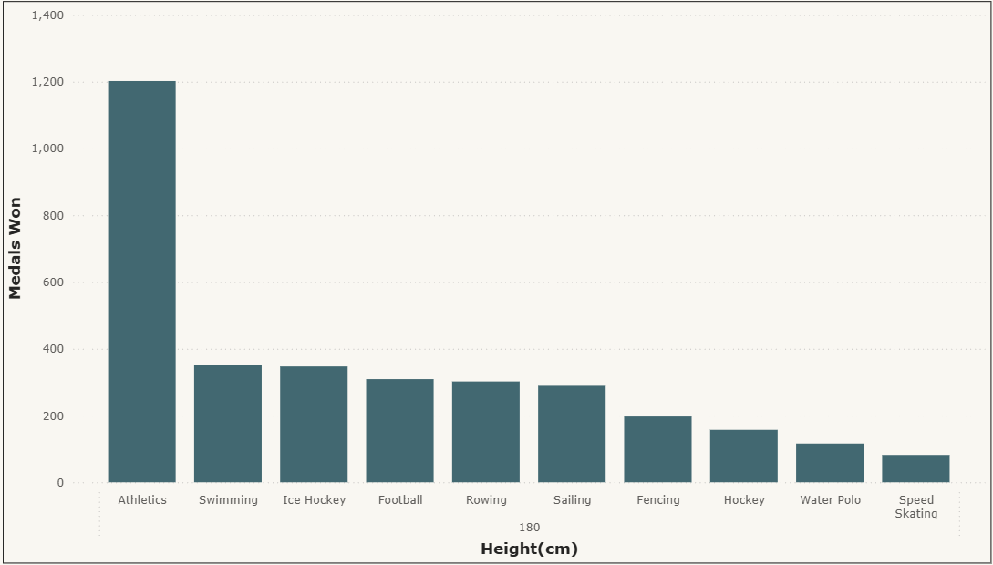
This chart illustrates the sports that achieve the highest success rates at the optimal height of 180 cm.
Notes:
Use GREEN gradient background with abstract waves and Olympic rings.

Slide 17
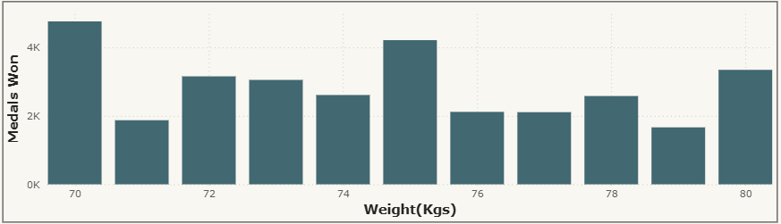
This chart shows that 70 kgs is the most frequent weight among successful athletes.
Notes:
Use GREEN gradient background with abstract waves and Olympic rings.

Slide 18
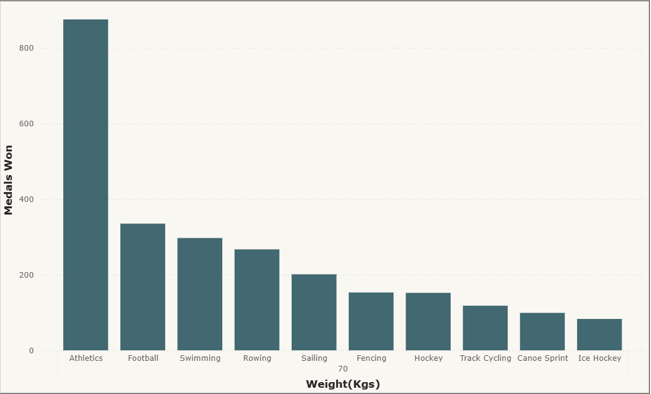
This chart illustrates the sport with the highest success rate within the most successful weight category, specifically 70 kg.
Notes:
Use GREEN gradient background with abstract waves and Olympic rings.

Slide 19
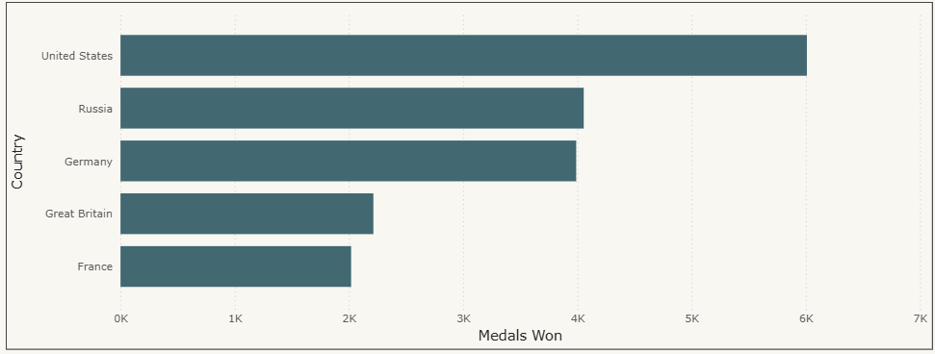
The United States leads with over 5,000 medals, followed by Russia, Germany—which is closing the gap—and then Britain and France.
Notes:
Use GREEN gradient background with abstract waves and Olympic rings.

Slide 20
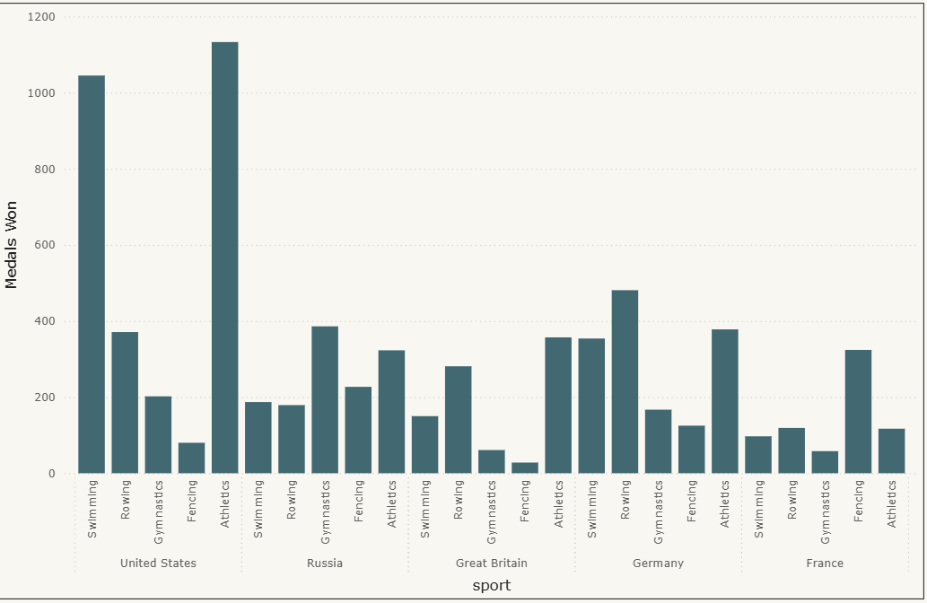
This chart displays the sports in which the top five countries have excelled the most.
Notes:
Use GREEN gradient background with abstract waves and Olympic rings.

Slide 21
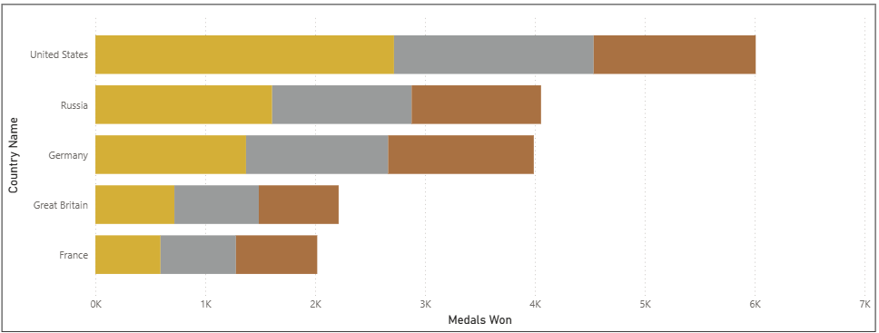
The USA leads in total medals, followed by Russia and Germany, with Germany earning more bronze medals than Russia.
Notes:
Use GREEN gradient background with abstract waves and Olympic rings.

Slide 22
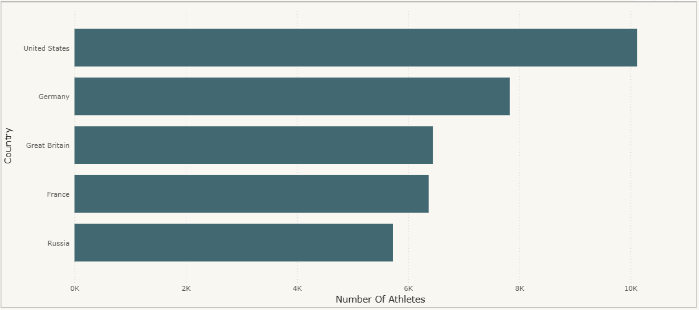
The USA has clearly produced the most athletes over time. This map also shows that a country's athlete numbers don't always correlate with its population size.
Notes:
Use GREEN gradient background with abstract waves and Olympic rings.

Slide 23
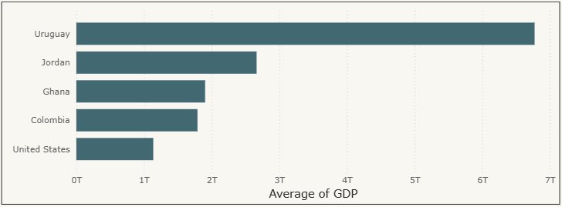
The average GDPs of the top 5 countries from 1960 to 2017 show that Olympic success is not strongly linked to a country’s GDP.
Notes:
Use GREEN gradient background with abstract waves and Olympic rings.

Slide 24
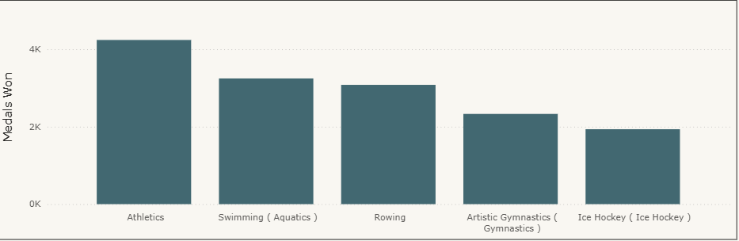
Athletics is the most popular sport worldwide and tops the medal count, followed by swimming, rowing, gymnastics, and ice hockey.
Notes:
Use GREEN gradient background with abstract waves and Olympic rings.

Slide 25
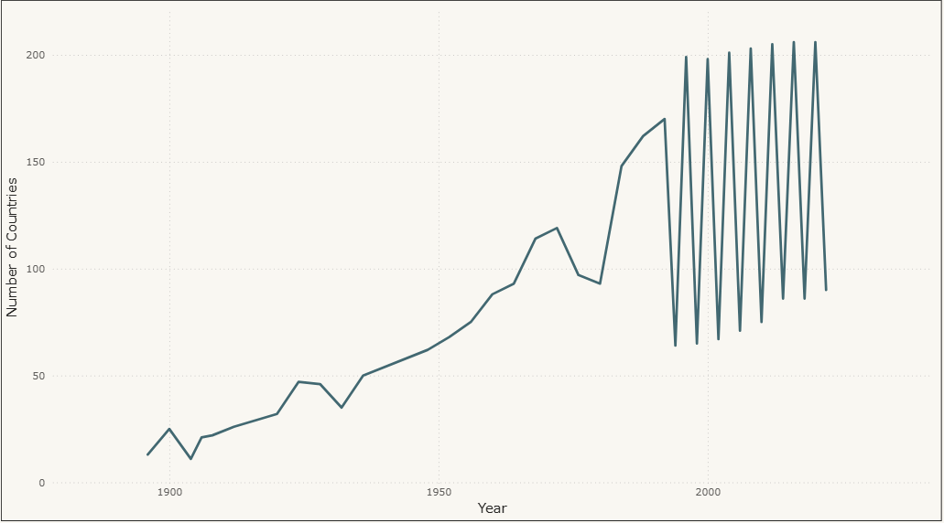
The graph illustrates a yearly rise in countries participating in the Olympics, notably after the Winter Games began, boosting diversity.
Notes:
Use GREEN gradient background with abstract waves and Olympic rings.

Slide 26
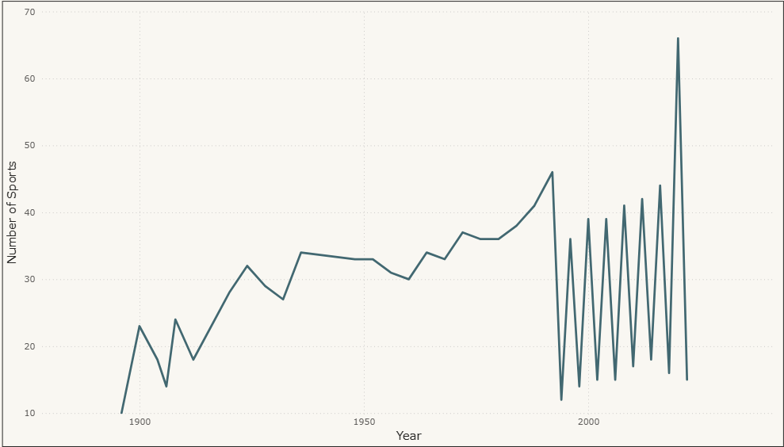
This graph depicts a steady growth in the number of sports over time.
Notes:
Use GREEN gradient background with abstract waves and Olympic rings.

Slide 27
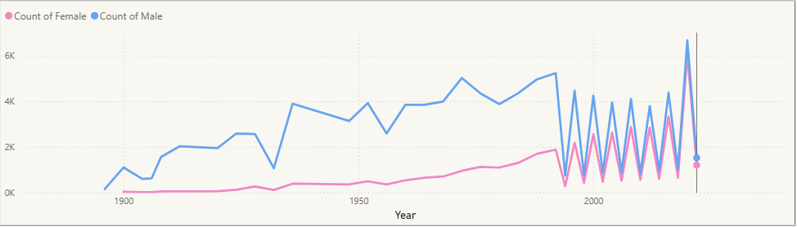
The graph shows female participation started low, rose steadily from the 1950s, and is now almost equal to male participation.
Notes:
Use GREEN gradient background with abstract waves and Olympic rings.

Slide 28
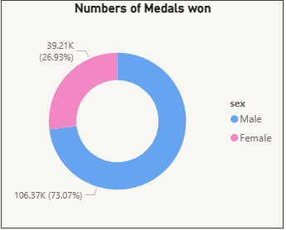
This graph shows the success of males versus females over time.
Notes:
Use GREEN gradient background with abstract waves and Olympic rings.

Slide 29
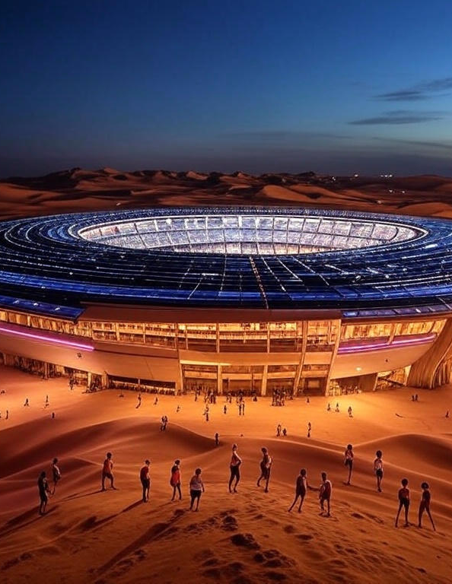
Future Of the Games
The Olympic Esports Games, postponed from 2025 in Saudi Arabia, will showcase virtual Olympic-related sports for digital audiences, excluding violent games. The Olympics, with a 128-year history, have united nations through challenges like wars and pandemics.

Slide 30
MORE SPORTS CAME TO EXISTENCE!
Upcoming Years (2026–2034)
Based on confirmed plans for future Olympics:
2026 Milan-Cortina Winter Olympics: Ski mountaineering (new sport, 1 addition).
2028 Los Angeles Summer Olympics: Flag football, squash (new), baseball/softball, cricket, lacrosse (reintroduced, 5 additions).

Slide 31
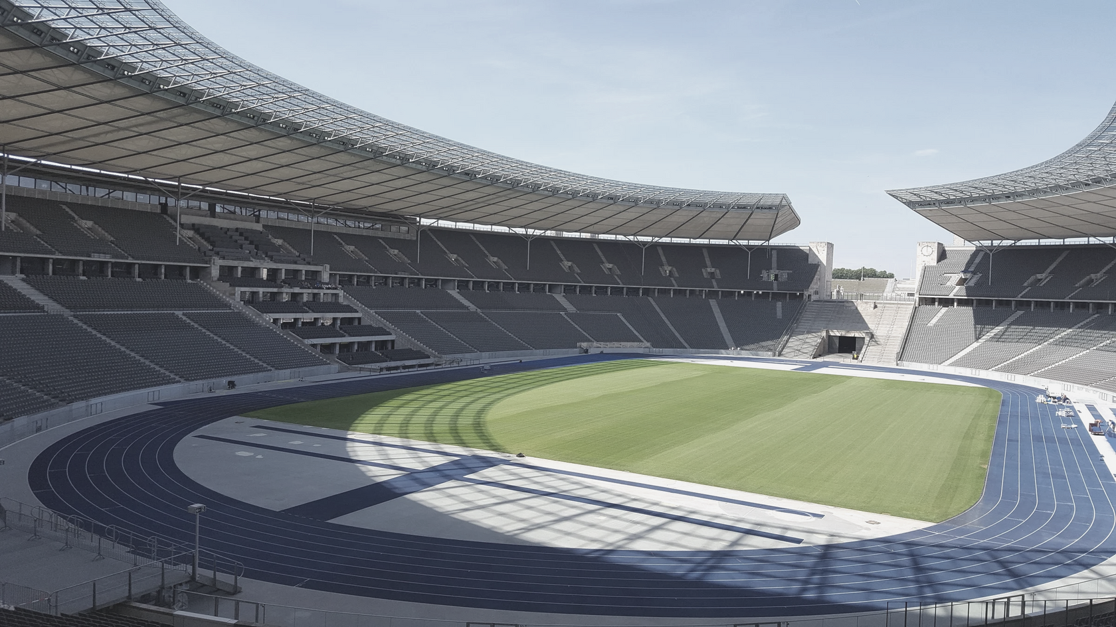
Hope we all learned today.

